Slide 1
Algorithm Recognition & Recommendation System
Richard Thai
Kurtis Zimmerman
Advisor
Dr. Chandan Rupakheti
Notes:
Richard

Slide 2
Problem Definition
Help novice programmers correctly implement common algorithms
Cases to consider
Incomplete source code
Compilable
Notes:
Kurtis
AST requires lots of heuristics,
CFG gives us more info to infer off of

Slide 3
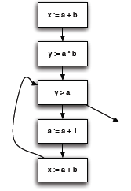
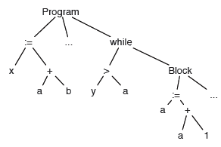
Problem Definition
x := a + b;
y := a * b;
while (y > a) {
a := a + 1;
x := a + b;
}
http://vinaytech.wordpress.com/2008/10/04/abstract-syntax-tree/
Notes:
Kurtis

Slide 4
Problem Definition
A
A
Delete D
Add F to C
B
C
B
C
D
E
E
G
A
Relabel A as G
B
C
B
C
E
F
E
F
Notes:
Richard

Slide 5
Context
Static Analysis
“Recommendation systems for
software engineering”
(Robillard, Walker, and Zimmermann)
RSSE Conference
Notes:
Richard
- RSSE = SW app that gives you useful information in a given context
- Other recommendations from RSSE

Slide 6
Pattern Definition Language
To define software patterns
Program Analysis Framework
To collect artifacts from a code base
and build a corresponding PDL model
Recommendation Engine
To evaluate differences between the
developer’s model and the PDL model
User Interface
To present the recommended
changes to the developer
Notes:
Kurtis

Slide 7
Approach
Tree/graph-matching problem
Suggest edits to correct implementation
Implement as an Eclipse plugin
Notes:
Limitations:
- when do we give recommendations?
- what if we give incorrect recommendations? (consider offering multiple recommendations)
now what if you offer multiple recommendations and there are too many, consider prioritizing them, now how do we prioritize the? (consider usability study)
amount of data could limit how fast we can react. consider using heuristics for analysis triggering, probabilistic modeling (a solution shouldn't even be considered)
Richard

Slide 8
Pattern Definition Language
To define software patterns
Program Analysis Framework
To collect artifacts from a code base
and build a corresponding PDL model
Recommendation Engine
To evaluate differences between the
developer’s model and the PDL model
User Interface
To present the recommended
changes to the developer
Notes:
Progress
Graph matching
Recommendations
Eclipse
Kurtis

Slide 9
Progress: Graph Matching
Branch and bound (Allen, et.al; 1997)
Exact graph matching (Etheredge; 2010)
Similarity matrix
pq-Gram (Augsten, et. al; 2005)
Notes:
Kurtis

Slide 10
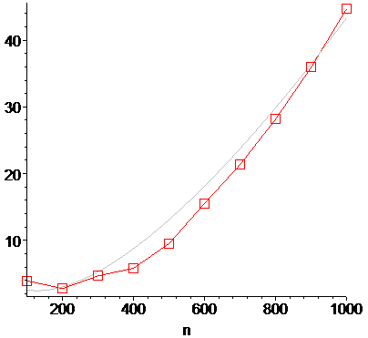
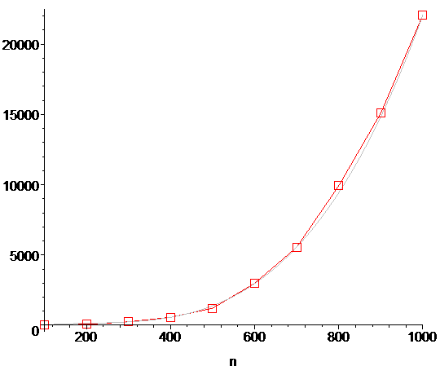
Progress: Recommendations
pq-Gram Similarity matrix
Time (ms)
Time (ms)
Number of nodes
Number of nodes
Notes:
Richard

Slide 11
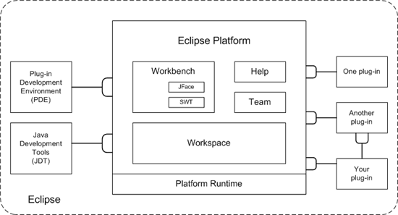
Progress: User Interface
Eclipse Plugin Architecture
Produce abstract syntax tree using Java Development Tools
http://www.rajorshi.net/old/img/eclipse/part2/fig1.png
Notes:
Kurtis

Slide 12
Future directions
Abstract syntax tree vs. graph structure
Soot
Pattern Definition Language
More benchmarking
Usability studies
Notes:
- formative usability study (give the tool to a bunch of people, and give them a questionnaire at the end)
summative usability study (observe each user at a time, more detailed)
Richard

